Slide 1

Judge Webinar FCI Utility and Defence
Date: 10.01.2026
Presenter: HARI ARČON

Slide 2

Agenda
Tracking
Protection
Q&A
Judge webinar -10.01.2026 - HARI ARČON

Slide 3
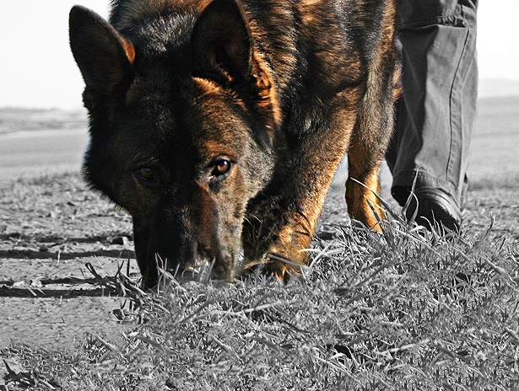
TRACKING

Slide 4
TRACKING – Q&A
Question: In the rule book, it is written that the judge can follow the handler to verify in the marking of the Object is correct. Should it not be specified that it is a duty for the judge to accompany the handler to the Object?
Answer: The Judge has to be in a position to be able to see where the object is placed.
Judge webinar -10.01.2026 - HARI ARČON

Slide 5
TRACKING – Q&A
Question: Earlier we had description about not putting the dog down before the Flag but only sit or stay – did we miss something or did it change?
Answer: It is allowed.
Judge webinar -10.01.2026 - HARI ARČON

Slide 6
TRACKING – Q&A
Question: Several questions where the dog must start searching after finding the object if the dog retrieves the object.
Answer: The dog must start the search where he leaves the object by the Handler.
Judge webinar -10.01.2026 - HARI ARČON

Slide 7
TRACKING – Q&A
Question: More clear description about doing control/check during the trackwork
Answer: See the whole picture - without leaving the track it is allowed.
Judge webinar -10.01.2026 - HARI ARČON

Slide 8
TRACKING – Q&A
Question: Description/clarification for how the Handler can act in the Corners.
Answer: The dog must show clearly how he makes the corner – the Handler must not influence how the dog takes the corner and continues the tracking.
Judge webinar -10.01.2026 - HARI ARČON

Slide 9
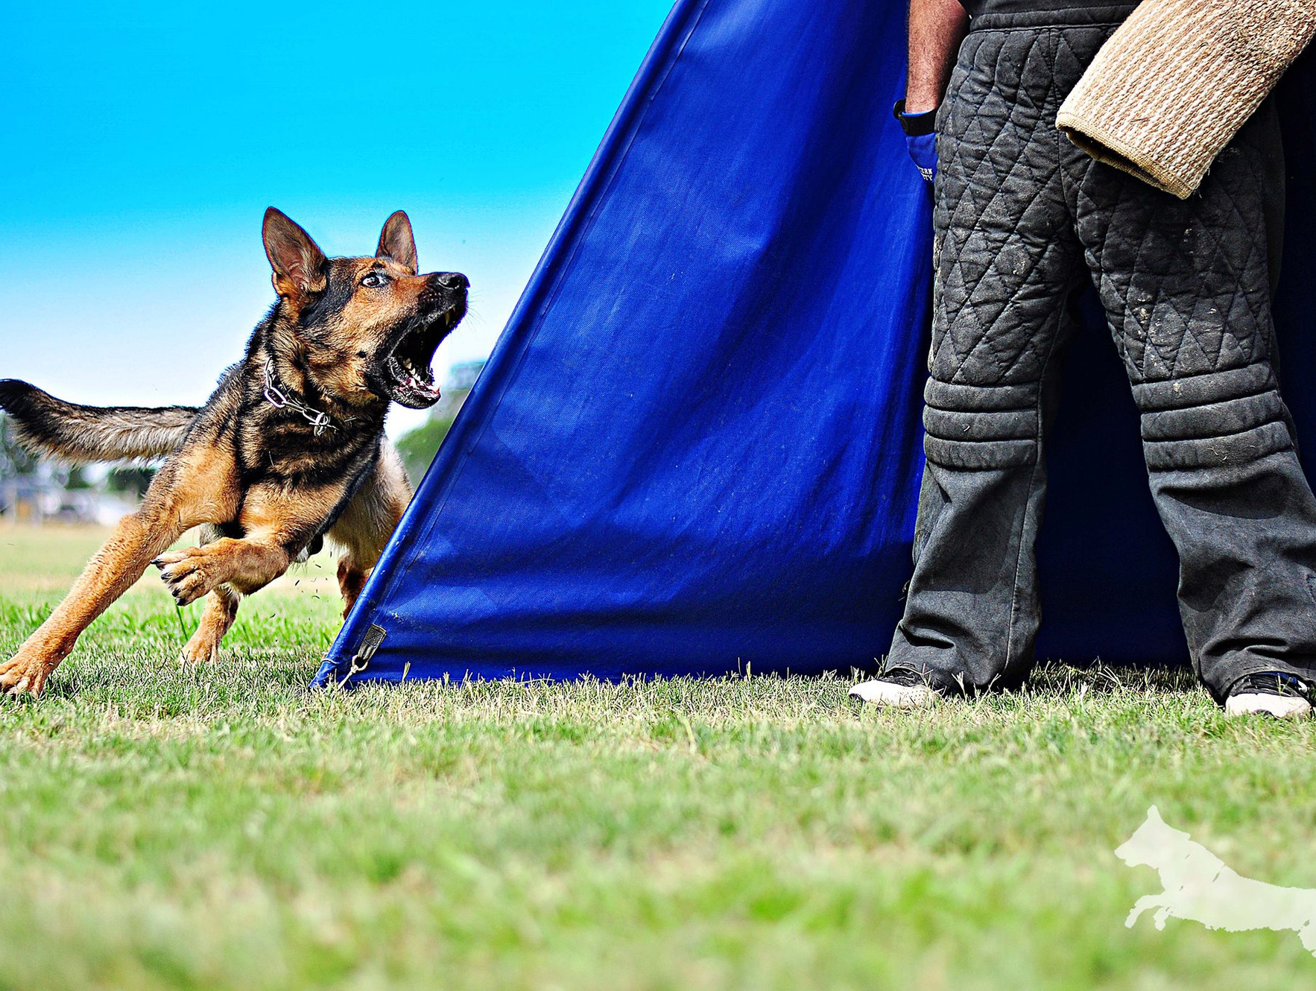
PROTECTION

Slide 10
PROTECTION – Q&A
Question: We have seen that under the new rules some helpers have started to give expelling sounds in some new places, for example attack on the dog out of the back transport. In the rulebook expelling sounds are mentioned only in 'Attack on the dog out of motion'. What is right way to do this?
Answer: The sound should be as described in the Rulebook.
Judge webinar -10.01.2026 - HARI ARČON

Slide 11
PROTECTION – Q&A
Question: Disarmament of the helper. Can the dog handler let the helper step back before the side transport?
Answer: It is allowed to ask the Helper to go back (3 steps).
Judge webinar -10.01.2026 - HARI ARČON

Slide 12
PROTECTION – Q&A
Question: What is the penalty if a dog does not correctly execute the blinds, goes directly to the last blind, but don’t stop, the handler with one command sends back the dog, which goes to the sixth blind and barks immediately.
Answer: Handler must take position in the right direction of the 'first' Blind. If the dog makes a mistake there will be a deduction of the points. If the Handler on purpose sends it directly to the Blind with the Helper, it will be rated with 0 point in all IGP-level.
Judge webinar -10.01.2026 - HARI ARČON

Slide 13
PROTECTION – Q&A
Question: During the escape, the dog and the helper falls: Must we do again an escape to then evaluate the out and the guarding phase? In this case, can we give all the points for the exercise?
Answer: If the Helper still has the Sleeve, we continue the work – if everything after this is ok you can have full point.
Judge webinar -10.01.2026 - HARI ARČON

Slide 14
PROTECTION – Q&A
Question: How is it allowed to use the leash as a help in IGP1 – is it like a x command or?
Answer: If you evaluate that the dog will not follow without this help it is like a x command.
Judge webinar -10.01.2026 - HARI ARČON

Slide 15
PROTECTION – Q&A
Question: Clarify that a short pause is required before the handler gives the dog the sit command during the guard phase.
Answer: The dog Handler must show the active guarding phase before giving the command for sit. Approx. 3 sec standing beside the dog before the command. The Handler is not allowed to touch the dog with the legs.
Judge webinar -10.01.2026 - HARI ARČON

Slide 16
Thank You for attending!
Date: 10.01.2026
Presenter: HARI ARČON

