Slide 1

WELCOME

Slide 2
Judge Meeting – Online
10. January 2026

Slide 3
IGP is not only a program for dogsport
IGP first is a program to select dogs for breeding!

Slide 4

Priorities in dog breeding
Health
Temper
Beauty

Slide 5
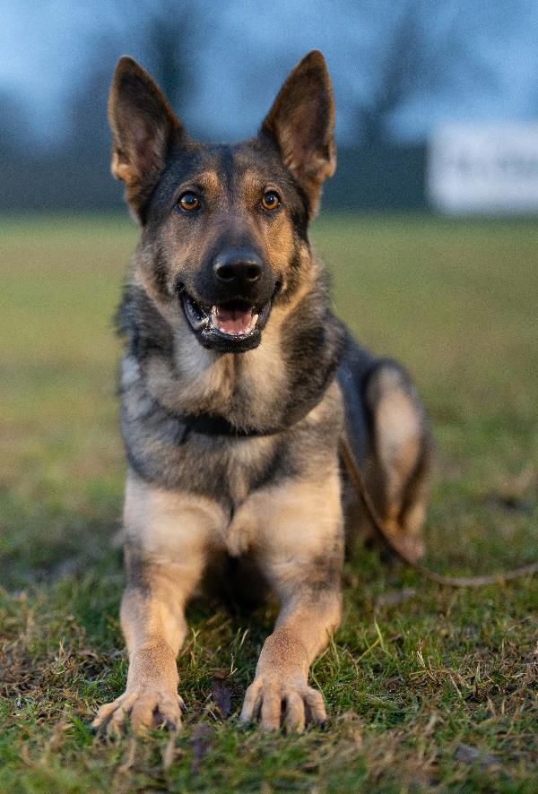
Dog owner requirements
A healthy dog!
A dog with strong character and nerves, which has no problems with the environment and causes no problems in the environment!
Beauty is in the eye of the beholder. Of course, a dog should correspond to the breed standard, whereby overtyping is to be rejected in every respect!

Slide 6
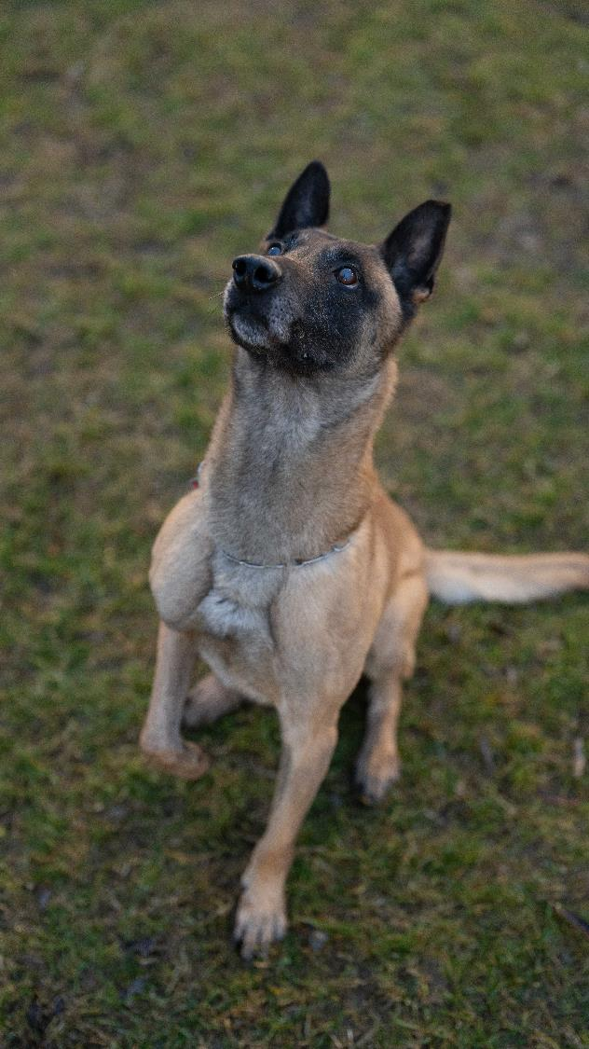
The purpose of pedigree dog breeding
To at least maintain or, if possible, to improve the breeding stock characteristics.

Slide 7
Development in recent decades
Faster
Higher
Continue
More - more - more
The specification came from the judges - the trainers adapted to it and the breeders have tried to breed more and more dogs with which this goal is possible

Slide 8
What is the goal of many breeders?
To breed dogs that possible high ratings at exhibitions
or
To breed dogs that are able to achieve high ratings at performance events.

Slide 9
What has been achieved?
Health problems in several breeds - no standard gives to breed dogs that are not healthy!
There are more and more dogs - in many working dog breeds - who have a very low threshold of irritation, a bad nervous condition and are no longer durable for “normal owners”.
The purpose of a test is to select dogs for breeding.

Slide 10

Responsibility of the judges
Both show and performance judge bear a great responsibility for the development of the breeds!

Slide 11
What can we judge?
Only the phenotype!
It is almost impossible to judge why a dog behaves this way during an event.
It is also irrelevant for the assessment - only a self-confident, strong-natured dog deserves a maximum rating!
Dogs with significant restrictions may not find entry into the breeding.

Slide 12
Stimulus - stimulus threshold
Trigger of an aggression behavior is always a stimulus.
Low threshold - choleric - undesirable
Medium threshold - Sanguine - desired
High threshold - phlegmatic - undesirable

Slide 13
Stress means pressure, strain
Stress primarily has the evolutionary function of increasing the attention and tension of the organism by releasing stress hormones in order to react quickly in dangerous situations.
Stress is therefore originally a natural positive reaction of the body.

Slide 14
Stress
Stress is not fundamentally negative.
Stress increases responsiveness through accelerated breathing, increased heart rate, dilation of the pupils, better supply of the muscles, rise in blood sugar, tension, changed posture and facial expressions
Stress is positive if a solution is found or a solution (positive experience) can be used.

Slide 15
Expressive behaviour
Expression is what the dog expresses from the inside out

Slide 16
Beginning and end of the test
The examination begins with the submission of the performance booklet, and it ends with the return of the performance booklet.
The award ceremony is still part of the examination and still counts as an assessment of social compatibility.
Dogs who are disqualified due to unwanted aggression behavior must repeat the BH-VT and complete it positively before the next start.

Slide 17
Termination of the exams
Due to illness or injury can also be done against the will of the dog handler, if the dog cannot meet the requirements of the examination regulations in the opinion of the performance judge.
If a dog handler cancels the examination without presenting a certificate or against the opinion of the performance judge that the dog is sick, the entry in the performance booklet is deficient “due to termination of the dog handler".

Slide 18
Evaluation
The evaluation is based on grades - from which the points are derived.
“Point judging" is to be rejected - this makes the performance judge a "fault judge" and not a performance judge. We don`t pull off points – we give points!

Slide 19
Entry for World-Championship Tracking
In the specifications we have: FCI I-FH (2 tracks)
Many nations cannot offer this test and would therefore have to hold it in other countries.
Decision: Prerequisite for participation in the World Championship: FCI-FH 3

Slide 20
Judges for FCI-IGP World Championship
Supervisor A Nenad Milojevic Serbia
Judge: Robert Fagos CZ
Supervisor B/C Igor Lengvarsky SK
Judge B: Lene Carlson DK
Judge C: Robert Markschläger A

Slide 21
Judges Tracking World Championship
Supervisor Klaus-Jürgen Glüh D
Judge: Aivo Oblikas Estonia
Judge: Saso Cvek SLO

Slide 22
Meeting with WUSV, FMBB, ISPU, ATIBOX
Inviteted also: Dobermann, Rottweiler
Hari Arcon, Clemente Crosso, Robert Markschläger, Josef Vornarburg, Edgar Scherkl, David Huber, Michael Heimbs, Juan Carlos Garcia Gonzalez
A very pleasant, collegial atmosphere!
Agreement was reached regarding minor adjustments to the regulations.
Joint continuing education for judges – specialized training for international championships.
Distinguishing between trials and competitions.
Ethics agreements for judges

Slide 23
FCI FH 1
The resting time is 90 minutes.
Due to organizational reasons, this causes problems during club examinations.
The resting time is reduced to 60 minutes.

Slide 24
Retrieve on flat
Instead of marking a square, only a minimum distance of 8 m and a maximum distance of 12 m are marked.
The side lines are omitted, and the angle at which the dumble lies is irrelevant.
If the dumble lies too short or too far, it is placed at the line (nearest point from where it was thrown).

Slide 25
Retrieve over the hurdle
The rectangle over the hurdle and the A-frame should be widened by 50 cm left and right.
The minimum distance to the hurdle should be reduced to 4 meters.
If the dumble does not land in the designated square, it will no longer be placed in the center, but rather at the line (where the dumble is closest, or where it fell out).

Slide 26
Retriev over the Scalling Wall
In FCI IGP 3, the minimum distance should be reduced to 4 meters – measured from the center of the obstacle
This is intended to encourage the dogs to perform a climbing jump rather than simply running over the obstacle at high speed.

Slide 27
Questions PO

Slide 28
Disqualification for Aggression
It is clear that the BH-VT only needs to be repeated in the event of disqualification due to aggression.
Entry in the score book: "Disqualification due to temperament issue - BH-VT retake"

Slide 29
Question about arm positioning in the basic position; our current translation says "relaxed against the body," which may seem inconsistent. Would it be possible to send clarification with an illustration of how the guide's arms should be positioned in this way? (An illustration similar to the one with the dog and the articles)
Where must the dog maintain focus during heeling? Is focusing on the armpit penalized? If so, what is the penalty? Is it assumed that the same applies to all developments? How much should be deducted if the other parameters are adequate? Attentive, focused, harmonious, and well-positioned.

Slide 30
The current regulations, state regarding free following without a leash, that only a single "heeling" command can be given at the start of the exercise, eliminating the possibility of two commands at the beginning of each change of pace or not?
Other questions:
We request if the possibility of evaluating whether those disqualified for not releasing should be penalized for termination, just as was done in tracking with the loss of control, thus allowing people who travel to a championship to participate, or maintaining the qualifications of the other disciplines.

Slide 31
1. What was the reason for including the rule prohibiting belly bags and so-called training aprons?
It is a help!

Slide 32
2. A more important question concerns the ratio of qualitative assessments to points. The table indicates that an excellent score begins at 96% of the final score. However, the lowest limit is 286, which is 95.3%. For an excellent score to begin at 96%, its lower limit must be 288 points. What is more important—points or percentages? This is because our athletes can earn athletic titles and ranks, but there must be an exact correspondence between points and qualitative assessments.

Slide 33
1. FCI World Championship – Ball IssueThree members of the expert commission were present at the FCI World Championship. It was noticed that several dogs carried balls during the awards ceremony. Since there was no reaction to this, the question arises as to how a uniform regulation or clear policy from the expert commission can be maintained.
In the future, we intend to ask dog handlers to refrain from this practice. It's a difficult problem. There's no qualification requirement for it. Furthermore, a microchip check would need to be carried out to ensure that the correct dog is participating.

