Slide 1
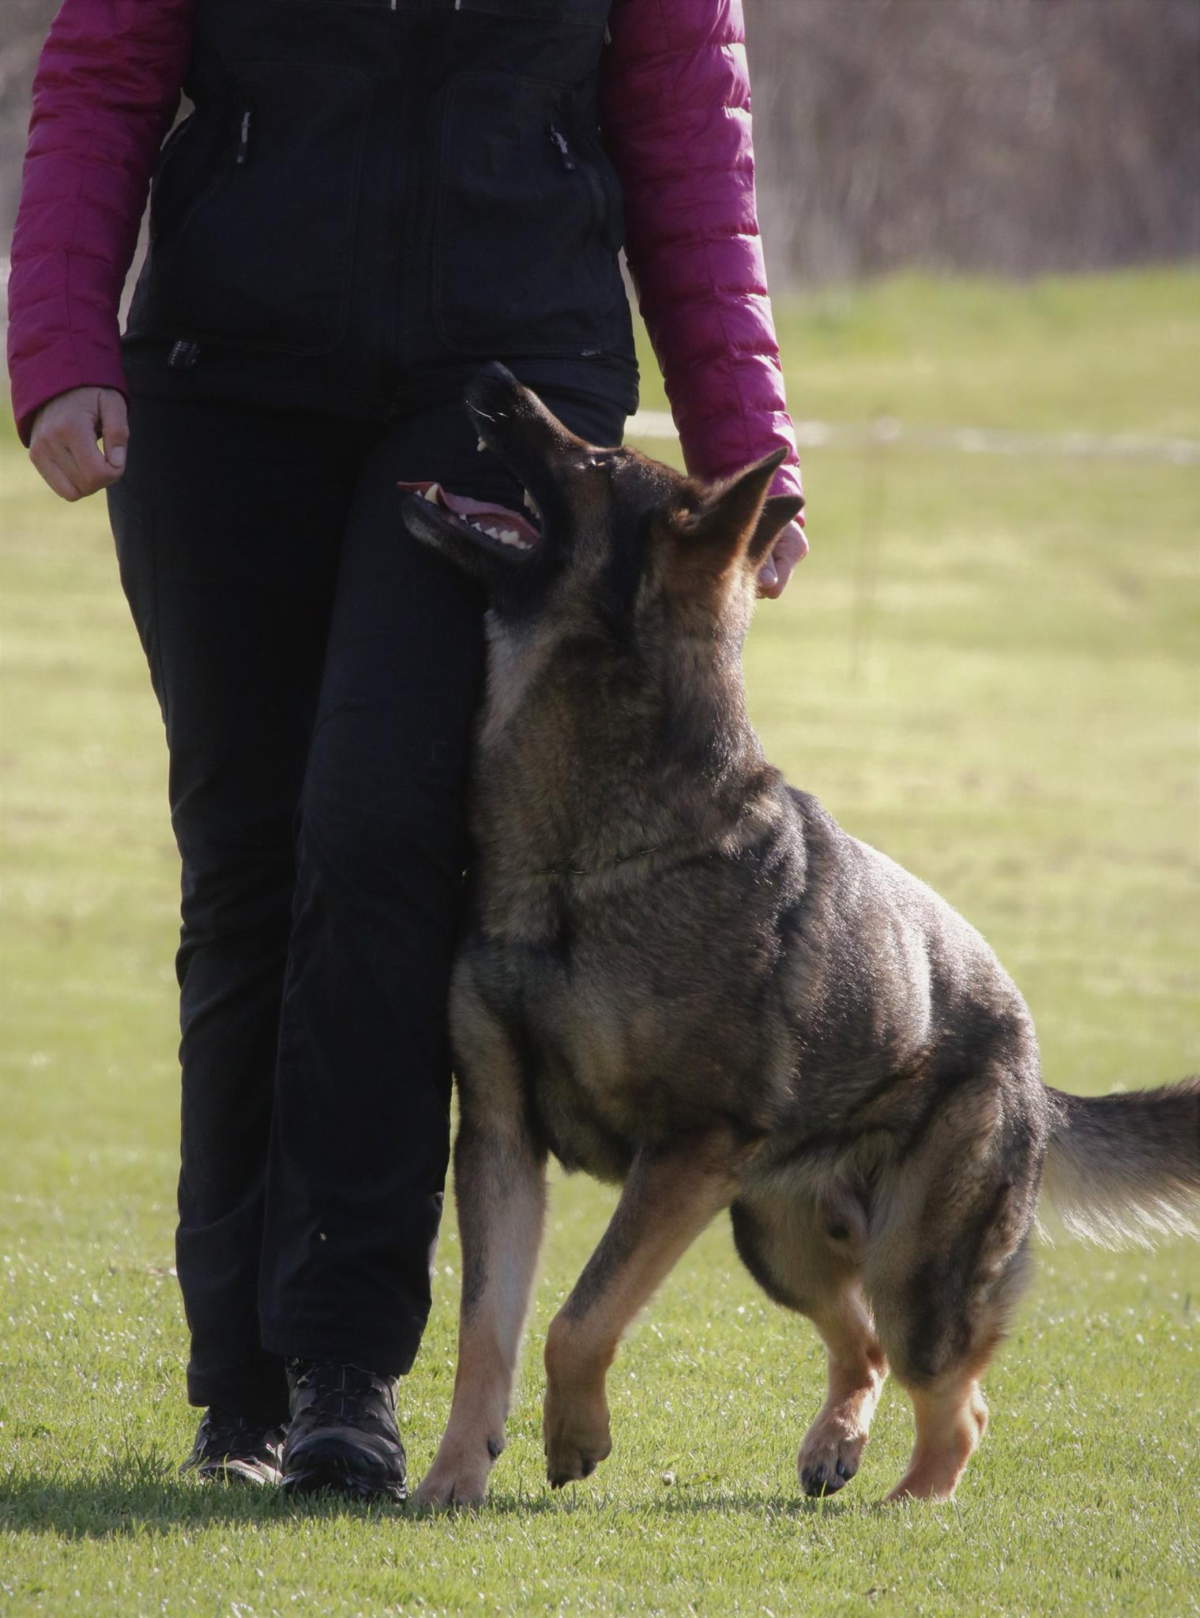
Obedience – grp. B

Slide 2
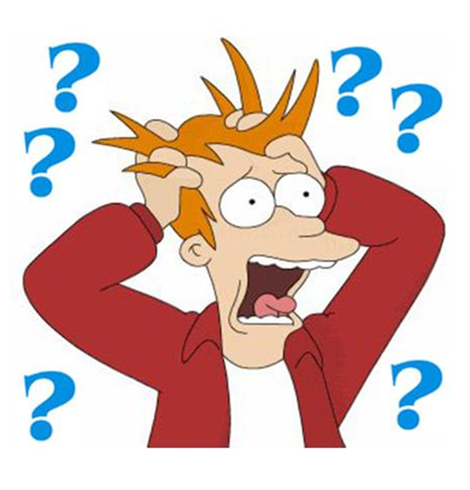
Questions from the Countries?

Slide 3
Handler/body/hand-help (in general) - more attention to handlerhelp
It must be taken as a x-tra command when a Handler helps the dog to perform an exercise.
Touching the dog during the work if it is not between the exercise for praise must be taken as a mistake/fault. Important to remember there is a different from judging an IGP1 in the Club and an IGP3 in a Championship.
It is important to know that there is a difference between Touching and holding/gripping the dog. In a Club Trial “Holding” will get a Yellow card opposite in a Qualification or Championship it is not to accept.

Slide 4
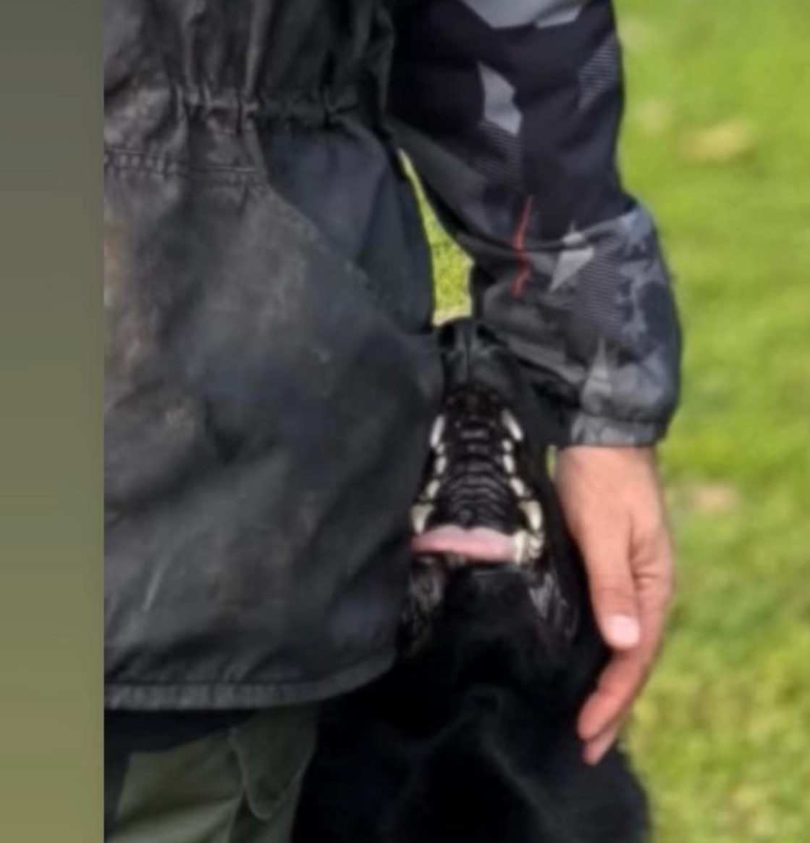
An excample for touching
This is a help and not showing the basic position in a natural relaxed way
The Handler can in this way prepare the dog for next exercise or help being in the right position
It is a sign for the dog when to stop and start – removing the hand is a start signal
Again, be aware what kind of trial you as a Judge is judging

Slide 5
How to take the Basic Position
There are several ways to take basic position – the Handler must stand in a natural position with the hands down along with the body without moving and with one command to get dog in the basic position.
The dog can go around the Handler
The Dog can make a turn (right like a circle)
The dog can go forward to the right and make a turn
It must be energetic and directly

Slide 6
How to judge the Bring exercise if the dog runs for the Dumbbell and the Dumbbell is not inside the square and still not replaced (the steward is not in the square)?
The Rating will be in Good (G)

Slide 7
Question: The dog must be led in free sequence between the exercises. In which exercise does the evaluation go in the event of misconduct? Free sequence or into the exercise you are currently performing (the next exercise does not start until the basic position)? The dog must be led in free heeling between exercises. Which exercise is evaluated in the event of misconduct? The exercise free heeling or exercise just performed (the next exercise only begins with the basic position)?
Answer: Don’t let this be your FOCUS – you as a Judge can evaluate during the Trial if the dog is under control or not – it is allowed that the dog is relaxed between the exercises.

Slide 8
The current regulations state regarding free following without a leash, that only a single "heeling" command can be given at the start of the exercise, eliminating the possibility of two commands at the beginning of each change of pace or not?
It is only allowed to give one command when you start an exercise, also when you change your speed as a Handler (going from Normal Run Slow Normal you must give a command

Slide 9
Changing the basic position. To what extent is a partial assessment still possible and at what point is the exercise without Rating? Change of basic position. To what extent is partial assessment still possible, and at what point does the exercise no longer count?
If I understand this question right, I will answer it in the way that you are as a Handler you have always the right of taking ONE step forward (only) before the next exercise otherwise it will be a part of the exercise and will be deducted.
Also, it is not allowed to give a x-tra command for sit in the basic position after making the “ready-sign” to the Judge
Always prefer that the Handler shows approx. 3 sec. under and during the exercises

Slide 10
How must the rule about taking positions be done?
For example, in the stand while running or down with recall exercise: when the dog, on the handler’s command, first jumps up and only then takes the required position. (Many people train it this way, how to be Judge?)
The dog has to react immediately on a command in a positive way and perform the exercise requested
All these “habits” that the trainers/Handlers put in their training must be stopped by taking points for this
It is always for us as a Judge to evaluate the exercise in all and see if the dog are making a “circus” instead of doing as described in the Rulebook
For the part with the command for Sit, Down and Stand you can deduct one point which means that the hole exercise can be rated with a SG if everything else is ok

Slide 11
How to penalize a handler who intentionally throws the dumbbell outside the Square?
It is important that our ”Sporter” follows the rule from the rulebook and not show un-sporting behavior
We think that bringing the change in for the square it will not happen (anymore 😜)

Slide 12
In the Free Jump in IGP1 and IGP2 the rulebook says that 2 commands are allowed: "jump" and "here". When is the latest time to give "here"-command?
The command jump/climb starts the exercise and when the dog is just above or/and on top of the Jump the command ”here” must be given.
Otherwise, it is a help and can be deducted

Slide 13
General question for the jumping exercises FCI IGP-1+2: The dog leaves the basic position before the handler has taken the recall position. When is a partial evaluation possible and how is it graded?
It is possible to score the exercise when the Handler is on the other side of the Jump not in the specific position for the recall.
The exercise can max be rated with a high insufficient
Rating of the Free Jumps in IGP1 is 5/5/5 and 15 for the Scaling Wall (hole picture, no jump gives 0 point)
Rating of the Free Jump in IGP2 is 10 point (no jump gives 0 point)
Rating of the Scaling Wall in IGP3 is 5 for the Jump and 5 for the obedience part with the Dumbbell

Slide 14
When and how is the instruction given in the send out for the x-tra commands for the dog to stop/lay down in the “Send-Out”?
The Judge will give the sign for a x-tra command if the dog does not react on the first command from the Handler
If the Handler does not follow the instruction the exercise will be terminated

Slide 15
In the “Send Out”, clarify when the complete exercise becomes 0 in the second part of the exercise in case of doesn’t stop.
After giving two x-tra commands and the dog does not stop – the hole excercise is rated with 0
If the dog turn on the first command and comming back to the Handler without stopping
If the dog does not allow itself to send at least 50% of the required distance forward, or if it does not allow itself to be stopped on 3 commands, the exercise will not be judged

Slide 16
With the current evaluation criteria what does the Commission consider to be the optimal Free healing?
GOOD QUESTION
I will not only say optimal Free Healing – also reaction and performing from the dog and Handler
Video (Risenschnauzer)

Slide 17
What did we see?
Harmony
Energy
Concentration
Co Work between Handler and Dog
Motivation
Willingness to work
Stability
Positive attitude and reaction getting the commands
Naturally healing and walk

Slide 18
Was everything correct?
NO
This is what is important with the new Rulebook that we can see the whole picture and not only count the mistakes and read the body language from the dog.
In our comments use the terms from the Rulebook and make sure to higher the primary things from the secondary in the exercises
Don’t ”kill” anybody especially not our ”normal” Handler’s in Club trials

Slide 19
The good example…….
Attitude, energy, quick reaction in a positive way. Natural basic position from the Handler
VIDEO
Important to remember
NOT FASTER FASTER
HARMONY

Slide 20
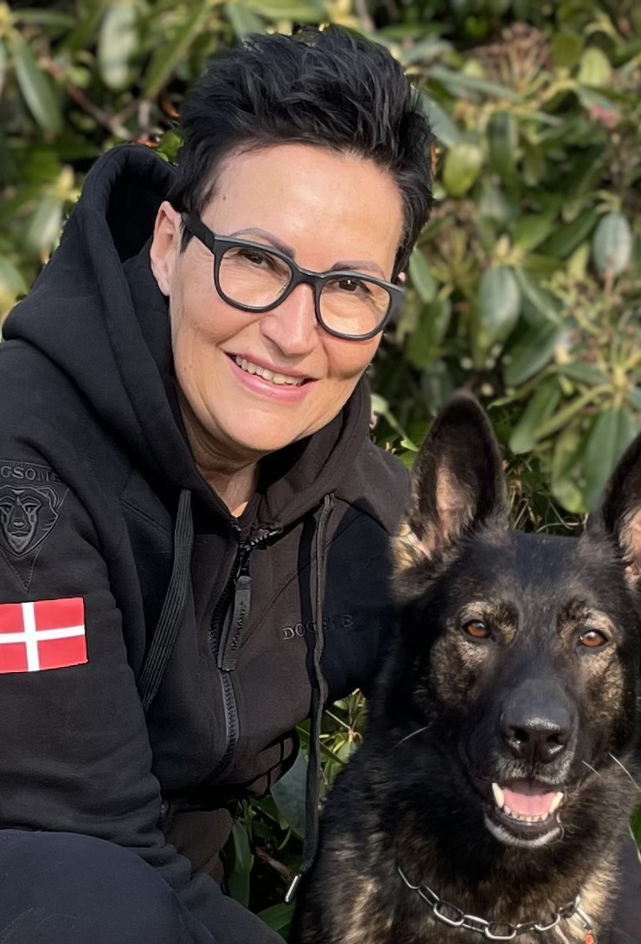
THANK YOU FOR YOUR ATTENTION

